Slide 1
2021 NCAA MBB Tournament Teams Prediction

Slide 2
Dataset description
Data from every d1 men's basketball team in 2021
347 Teams
25 Columns of statistics

Slide 3

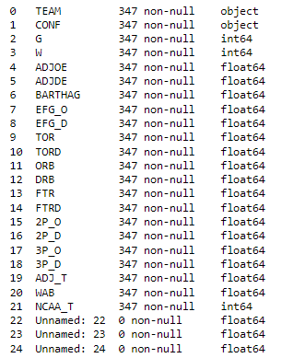
Columns and Datatypes

Slide 4
Changes to The dataset
Removed the team name and unnamed columns
Checked to see if there were missing values
Change seed to 1 or 0 if they did or didn't make the tournament

Slide 5
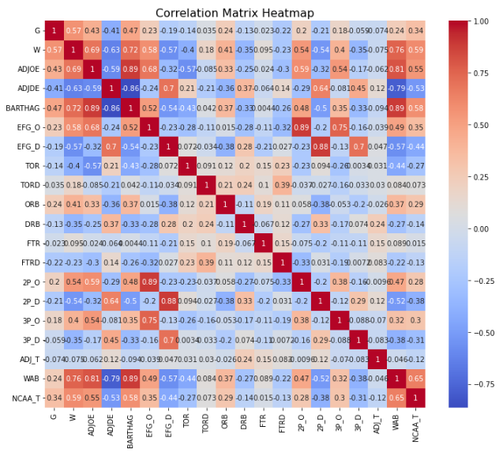

Slide 6
Experiment steps
Split dataset into independent and dependent variables
Used get_dummies to get 1 or 0 for categorical columns
Split data into training and test sets
Trained the Logistic Regression model
Made confusion matrix and classification report

Slide 7
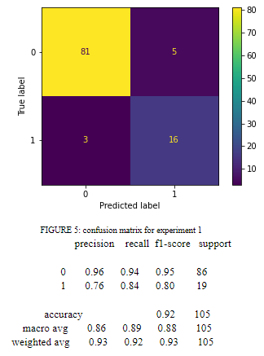
Experiment #1
Done with previously normalized dataset
Test size 30%

Slide 8
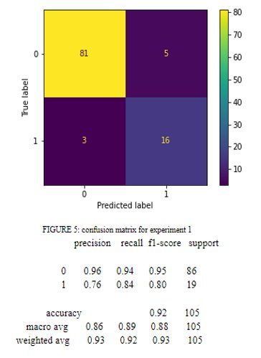
Experiment # 2
Same variables as experiment #1
Test size was changed to 20%

Slide 9
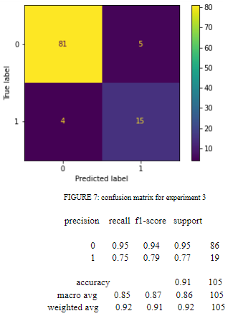
Experiment #3
Removed the ADJ_T column from set of variables
Test set size was set to 30%

Slide 10
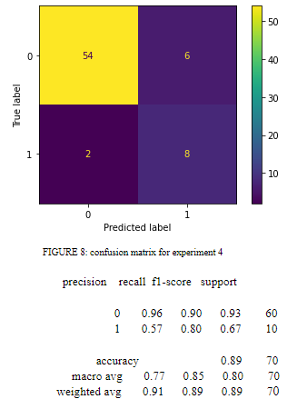
Experiment #4
Same variables as experiment #3
Test size was set to 20%

Slide 11
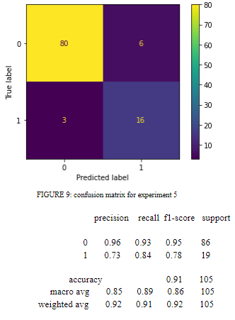
Experiment #5
Added ADJ_T column back to variables
Removed G and W variables
Test size set to 30%

Slide 12
Results & conclusion
Experiments #1, #3, and #5 performed 92%, 91%, and 91% percent accuracy scores
All models were more accurate at predicting negative cases (0) than positive cases (1)
For the future: find a better dataset that has more balanced data

